Slide 1
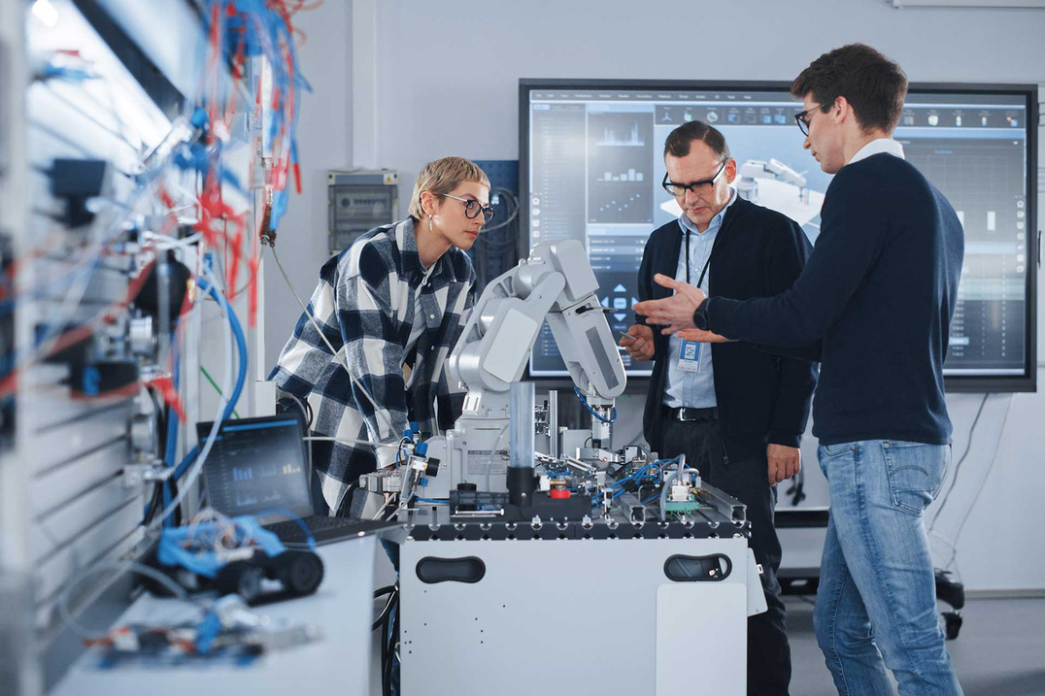


AI- Based Training an Assessment Tool For Vocational Education
24-25J-185
Notes:
‹#›

Slide 2



OUR TEAM
Vilajini.Y
IT2118928
Sujeevan.R
IT20657314
Niles A.P
IT21347726
Notes:
‹#›

Slide 3

Introduction
Research Problem
Objective
Overall System Diagram
Notes:
‹#›

Slide 4
Traditional vocational training methods follow a one-size-fits-all approach, failing to meet individual student needs
Students often lose interest in vocational training due to the lack of interactive and immersive learning experiences.
Research Problems
Traditional assessment methods are slow, leading to delayed that impacts student learning and skill development.
Vocational training programs often fail to keep up with rapidly changing industry demands, leading to outdated skillsets.
Notes:
‹#›

Slide 5
Develop an AI-based training and assessment tool that transforms vocational education by providing personalized learning experiences, automating assessments with real-time feedback, and enhancing student engagement through gamification and interactive learning modules.
Main Objective
Notes:
‹#›

Slide 6
AI-Viva Session and AI-chat bot
Skill-Based Personalized Learning Path
Sub Objectives
Gamification and Game-Based Learning for Vocational Education
Notes:
‹#›

Slide 7
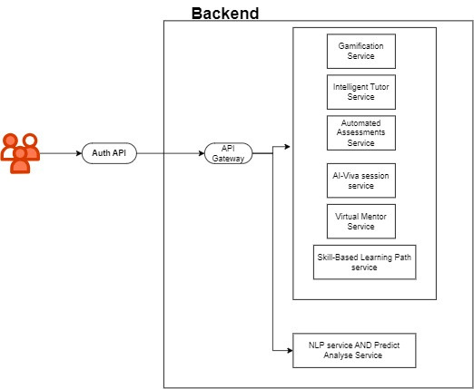
Overall System Diagram
IT21189258 | Vilajini.Y | 24-25J-185
Notes:
‹#›

Slide 8
AI-Viva Session and AI-chat bot
It21189258
Vilajini.Y
Information Technology
IT21189258 | Vilajini.Y | 24-25J-185
Notes:
‹#›

Slide 9
Background
AI-driven viva sessions simulate multiple questions.
Utilise AI to create a virtual mentor for vocational education.
Facilitate continuous improvement and skill development.
IT21189258 | Vilajini.Y | 24-25J-185
Notes:
‹#›

Slide 10
Research Question
How can AI-Viva sessions be developed to provide personalized assessments and enhance learning outcomes?
IT21189258 | Vilajini.Y | 24-25J-185
Notes:
‹#›

Slide 11


Research Gap
Features | Traditional ITS | AI-Driven Assessment Systems | Proposed System
AI-Driven Viva Simulations
Comprehensive NLP for Assessment
Context-Aware Adaptive Learning
IT21189258 | Vilajini.Y | 24-25J-185
Notes:
‹#›

Slide 12
System Diagram
Methodology
Tools and Technologies
Requirements
IT21189258 | Vilajini.Y | 24-25J-185
Notes:
‹#›

Slide 13
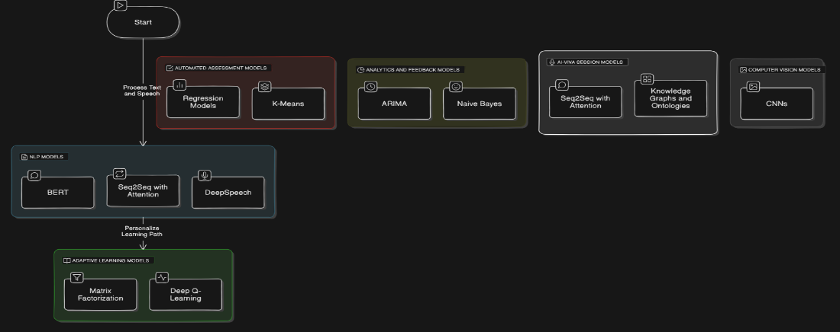
System Diagram
IT21189258 | Vilajini.Y | 24-25J-185
Notes:
‹#›

Slide 14

Tools and Technologies
Flask (Python)
Google-Cloud-API
ChatGPT-API for AI-Chatbot
IT21189258 | Vilajini.Y | 24-25J-185
Notes:
‹#›

Slide 15
Requirements
Functional Requirements
NON-Functional Requirements
User Authentication
AI-Viva Session
chat bot
Performance Analytics
Content Management
Communication Module
Integration with External Systems
Security
Performance
Reliability
Scalability
Usability
Maintainability
Compatibility
Accessibility
Localization
Data Backup and Recovery
IT21189258 | Vilajini.Y | 24-25J-185
Notes:
‹#›

Slide 16
References
Chassignol, M., Khoroshavin, A., Klimova, A., & Bilyatdinova, A. (2018). Artificial intelligence trends in education: A narrative overview. Procedia Computer Science, 136, 16-24.
Huang, G.-B., Zhu, Q.-Y., & Siew, C.-K. (2006). Extreme learning machine: theory and applications. Neurocomputing, 70(1-3), 489-501.
Jean-Charles, A. (2018). Internet of Things in Education: Artificial Intelligence Voice Assistant in the Classroom. Society for Information Technology & Teacher Education International Conference, 883-885.
Patrick, S., Kennedy, K., & Powell, A. (2013). Mean what you say: Defining and integrating personalised, blended and competency education. International Association for K-12 Online Learning.
IT21189258 | Vilajini.Y | 24-25J-185
Notes:
‹#›

Slide 17
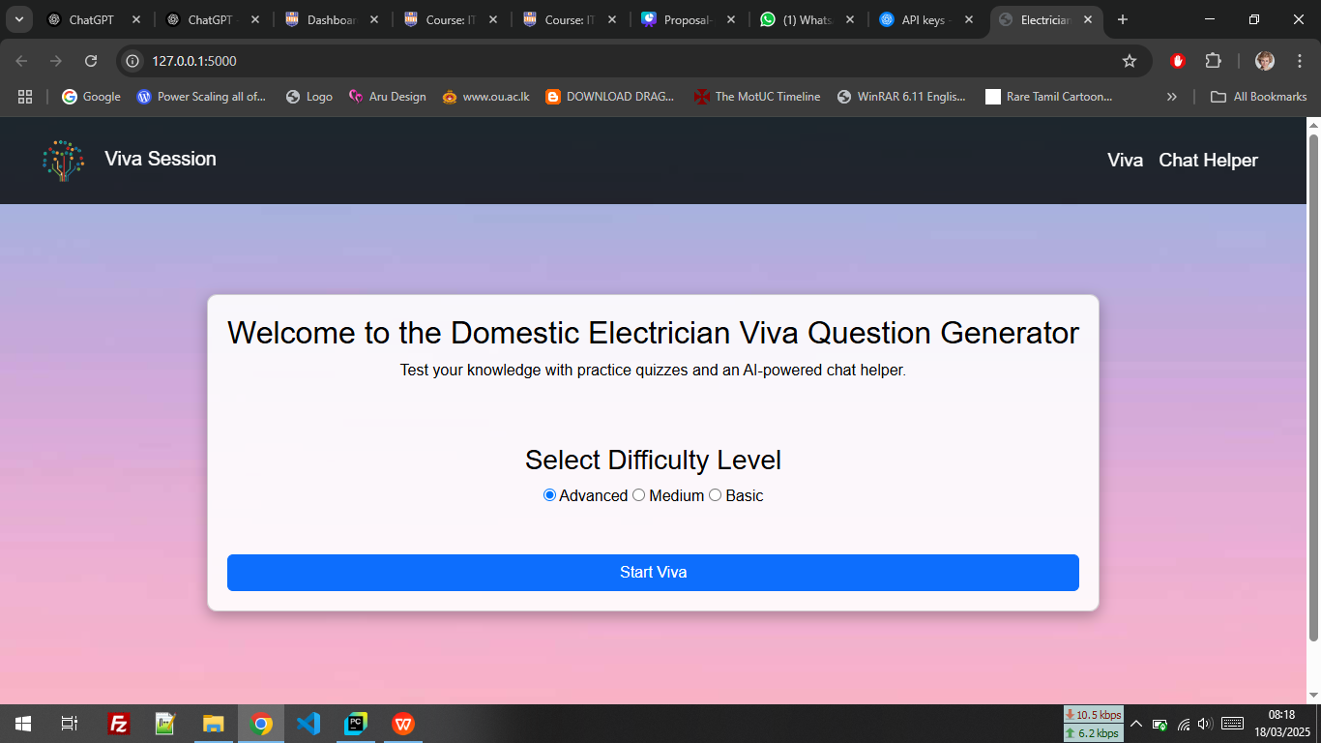
IT21189258 | Vilajini.Y | 24-25J-185
Notes:
‹#›

Slide 18

Skill-Based Personalized Learning Path
IT20657314
Sujeevan.R
Information Technology
IT20656314 | Sujeevan.R | 24-25J-185

Slide 19
Backround
Introduction
Research Question
Research Gap
Objectives
Methodology
IT20656314 | Sujeevan.R | 24-25J-185

Slide 20
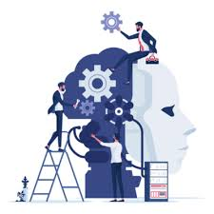
Backround
In recent years, personalised learning has become increasingly important, with a focus on adapting educational experiences to meet individual student needs.
Traditional educational systems often struggle to provide tailored learning paths, which can lead to student disengagement and uneven skill development.
AI-driven learning paths provide real-time adjustments, ensuring students receive appropriate content and challenges
IT20656314 | Sujeevan.R | 24-25J-185

Slide 21



Research Question
How can AI-driven learning enhance personalized education in vocational training for electricians?
What impact does skill-based classification have on student engagement and learning outcomes in vocational education?
How can a machine learning model effectively classify students into different skill levels (Beginner, Intermediate, Advanced) based on an initial assessment?
How does real-time content and quiz adaptation improve knowledge retention and course completion rates?
What role does personalized feedback and multilingual support play in improving accessibility and student performance in vocational training?
IT20656314 | Sujeevan.R | 24-25J-185

Slide 22
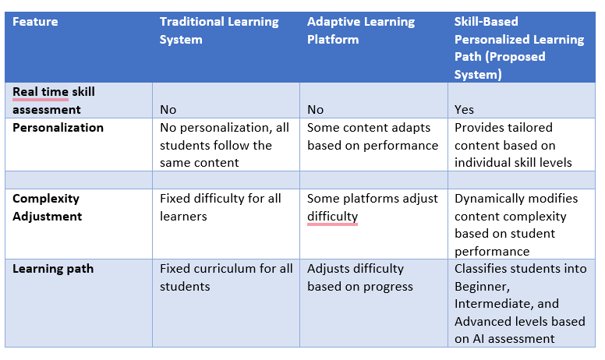
Research Gap
Novelty
AI-Driven Skill Classification
Real-Time Adaptive Learning
Intelligent Error-Based Learning
Multilingual Learning Environment
Personalized Pathways
IT20656314 | Sujeevan.R | 24-25J-185

Slide 23




Objectives
Main Objectives
Develop an AI-based skill-based personalized learning path for vocational education, specifically in the electrician course, to classify students based on their skill levels and personalize their learning experience.
Sub Objective
Implement real-time skill evaluation mechanisms to assess students' proficiency and classify them into skill levels (Beginner, Intermediate, Advanced).
Develop a mechanisum for complexity adjustment to modify content difficulty based on students' quiz performance and learning progress.
Design a system for continuous calibration of learning content, ensuring that students receive appropriate content, tutorials, and resources aligned with their skill level
IT20656314 | Sujeevan.R | 24-25J-185

Slide 24
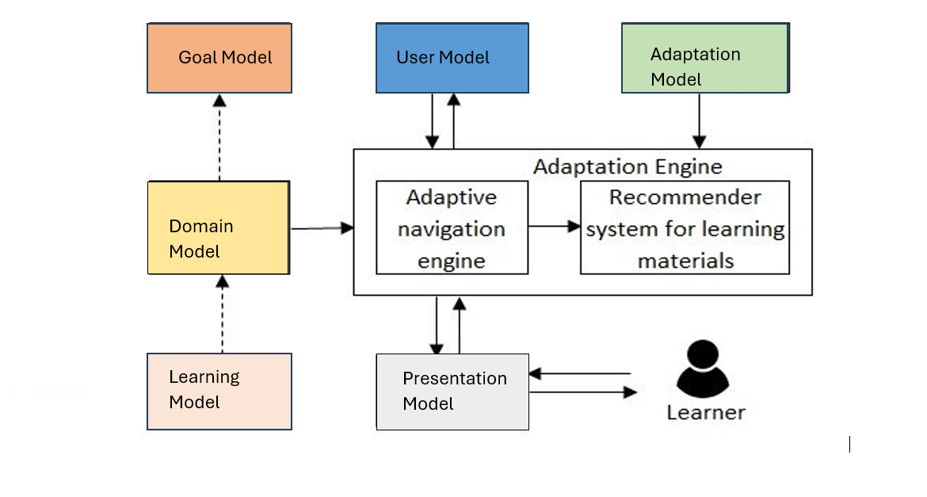
System Diagram
IT20656314 | Sujeevan.R | 24-25J-185

Slide 25

Component Specific Requirements
Functional requirements
Non-functional requirements
User Authentication
Skill-Based Classification System
Adaptive Learning Path
Content Management
Communication Module
Multilingual Support
Integration with External Systems
Availability
Reliability
Speed
Performance
Security
Privacy
IT20656314 | Sujeevan.R | 24-25J-185

Slide 26
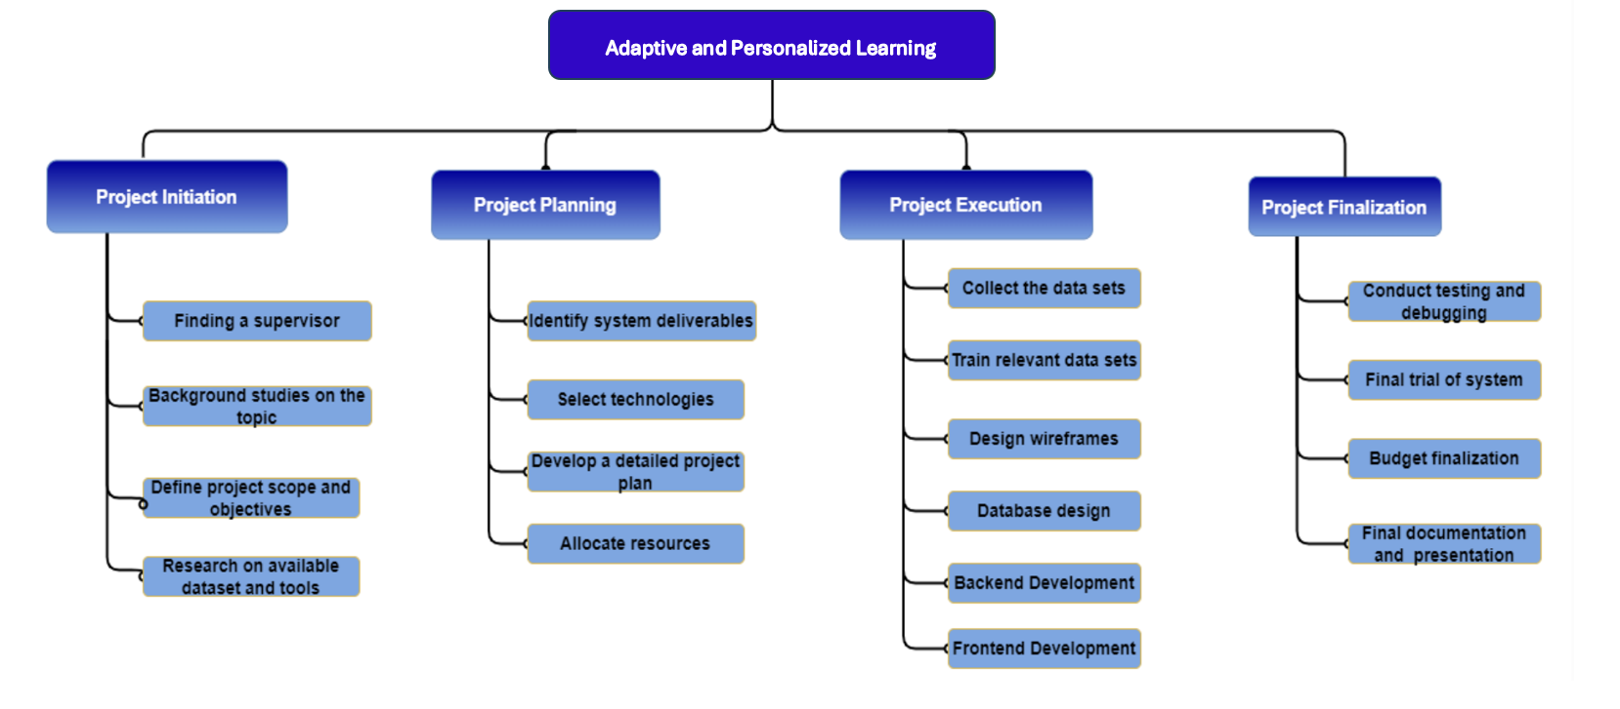
Work Breakdown Structure
IT20656314 | Sujeevan.R | 24-25J-185

Slide 27
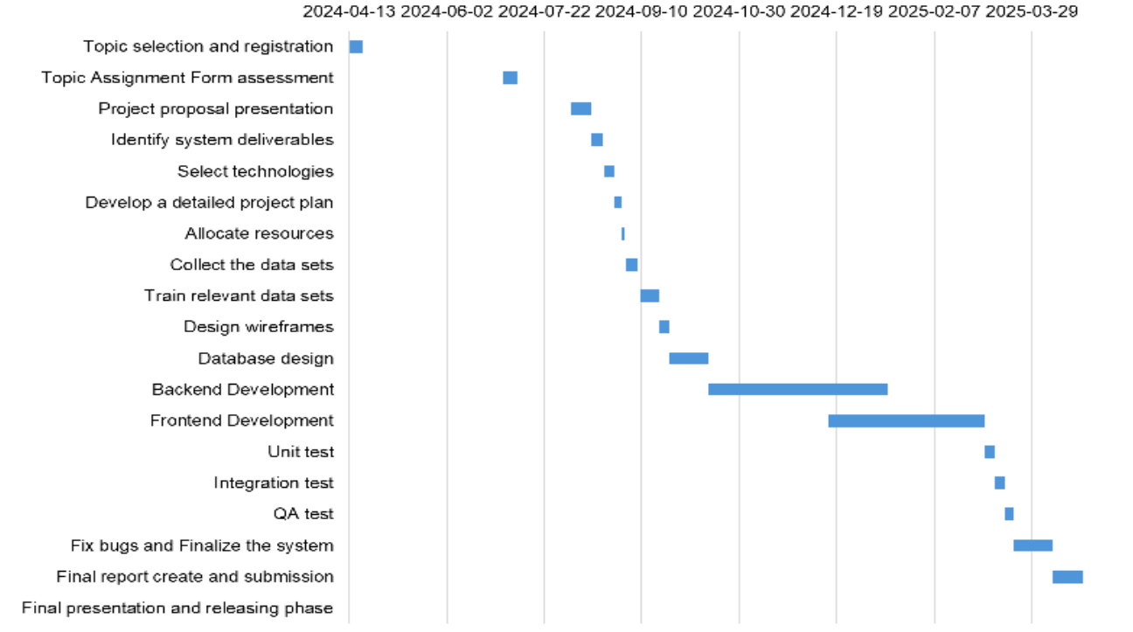
Gantt Chart
IT20656314 | Sujeevan.R | 24-25J-185

Slide 28

Methodology
Collect student data such as performance scores, course content, and engagement levels.
Clean and prepare the data for training, ensuring it's ready for the AI models.
Choose and build AI models that predict student performance and customize learning paths.
Train the AI models and test their accuracy to ensure they work effectively.
Integrate the AI with the educational platform, making it easy to use for students and teachers.
Allow the AI to adjust the difficulty of tasks based on how students are performing in real-time.
Keep track of student progress, with the AI constantly refining learning paths and materials.
Provide instant feedback to students and suggest ways to improve, using data to enhance the AI.
IT20656314 | Sujeevan.R | 24-25J-185

Slide 29
References
[1]J. Smith, R. Patel, and M. Brown, "AI-Driven Personalized Learning Systems: A Review," in Proc. IEEE Int. Conf. on e-Learning, 2023, pp. 124-129.
[2]A. Gomez, P. Clark, and S. Johnson, "Machine Learning Techniques for Personalized Education," in Proc. IEEE Global Engineering Education Conference (EDUCON), 2023, pp. 678-682.
[3]M. K. Lee and T. Kim, "Personalized Learning in AI-Enhanced Classrooms," in IEEE Transactions on Learning Technologies, vol. 15, no. 3, pp. 788-797, 2023.
IT20656314 | Sujeevan.R | 24-25J-185

Slide 30


Gamification and Game-Based Learning for Vocational Education
IT21347726
Niles A.P
Information Technology
IT21347726 | Niles A.P | 24-25J-185
08/07/24
<number>

Slide 31
Backround
Introduction
Research Question
Research Problems
Objectives
Methodology
IT21347726 | Niles A.P | 24-25J-185

Slide 32
Backround
Why is Gamification and Game-Based Learning for Vocational Education important?
Gamification and Game-Based Learning in vocational education make learning more engaging and effective by integrating interactive elements. This approach enhances skill development, motivation, and real-world application, better preparing students for modern job demands.
IT21347726 | Niles A.P | 24-25J-185

Slide 33
Research Problem
Main reasons why Gamification and Game-Based Learning for Vocational Education is important?
Enhanced Engagement: Increases student motivation and active participation in learning activities.
Practical Skill Development: Provides hands-on, risk-free practice of real-world tasks.
Improved Learning Outcomes: Facilitates better retention and understanding of complex concepts.
Personalized Learning: Adapts to individual student needs, allowing for customized learning paths.
IT21347726 | Niles A.P | 24-25J-185

Slide 34
Objectives
Main Objectives
Develop and implement gamified learning modules tailored for vocational education, incorporating virtual scenarios that address the specific training needs of electricians. Integrate collaborative learning approaches within the game-based environment and establish a robust progress tracking system for both learners and instructors.
Sub Objective
Identify and gamify key concepts in electrical systems.
Develop interactive modules with quizzes and games.
Create and refine realistic virtual scenarios for electricians.
Design team-based challenges and a platform for collaboration.
Implement a tracking system with analytics for monitoring progress and effectiveness.
IT21347726 | Niles A.P | 24-25J-185

Slide 35
System Diagram
Methodology
Tools and Technologies
Requirements
IT21347726 | Niles A.P | 24-25J-185

Slide 36
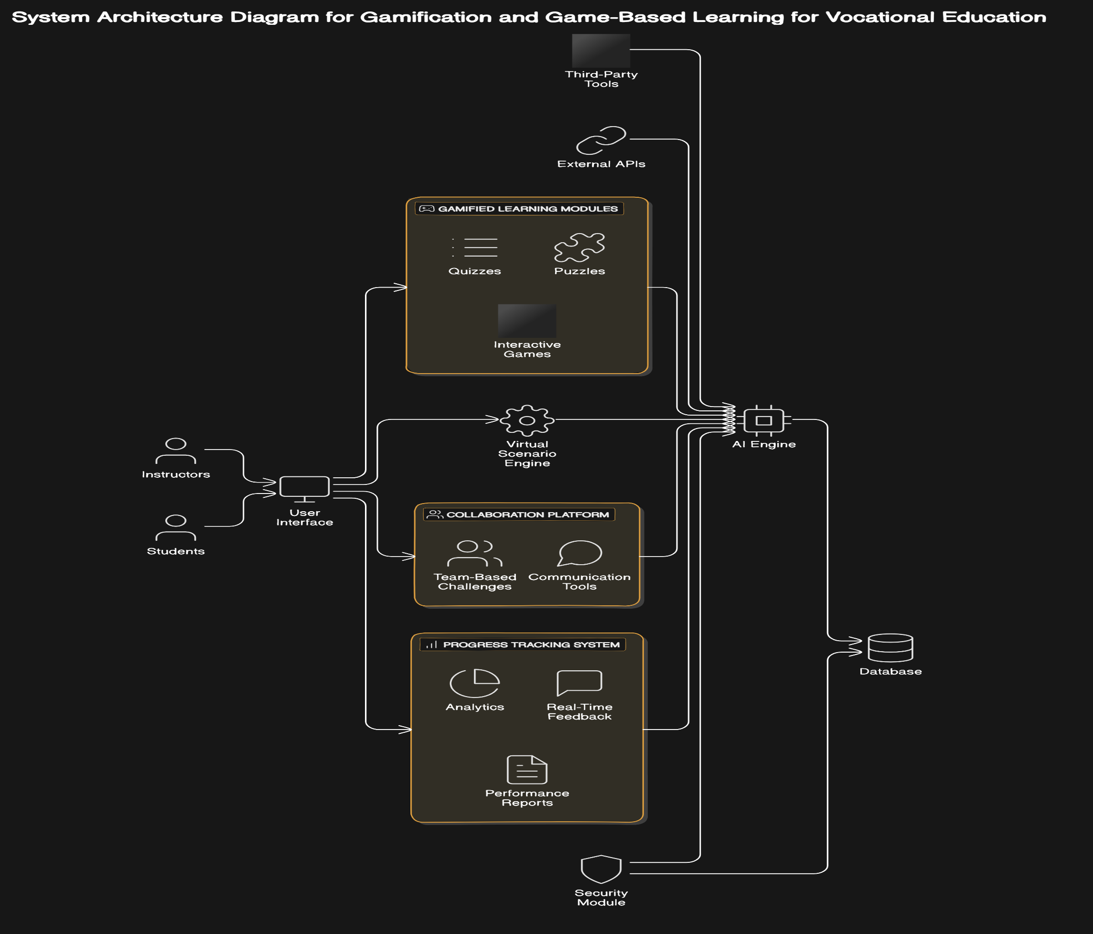
System Diagram
IT21347726 | Niles A.P | 24-25J-185

Slide 37



Tools and Technologies
C#
Python
Django
PostgreSQL
React
GitHub for version control
MS Planner for Project Management
IT21347726 | Niles A.P | 24-25J-185

Slide 38
Project Requirements
Functional requirements
Non-functional requirements
Provide gamified modules with quizzes and puzzles for electrical.
Enable realistic virtual scenarios simulating industry challenges.
Support team-based challenges and learner communication.
Track progress, offer real-time feedback, and generate performance reports.
Scalability
Usability
Performance
Security
Reliability
Compatibility
IT21347726 | Niles A.P | 24-25J-185

Slide 39
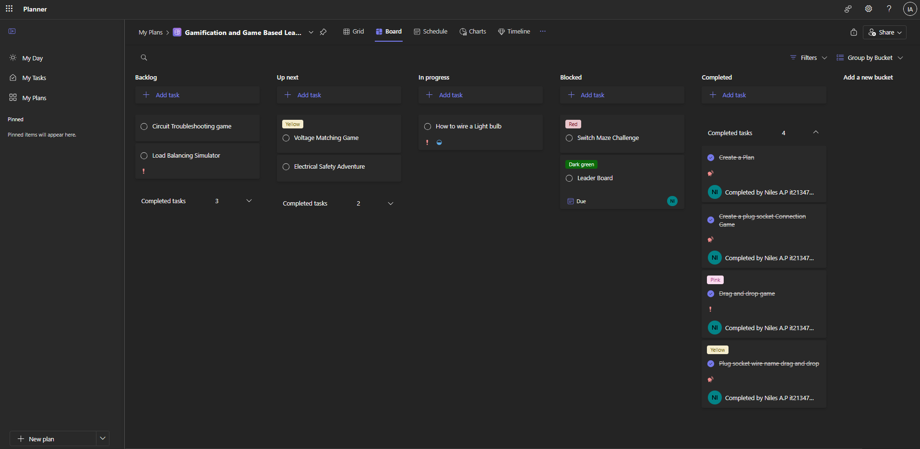
Project Management - MS Planner
IT21347726 | Niles A.P | 24-25J-185

Slide 40
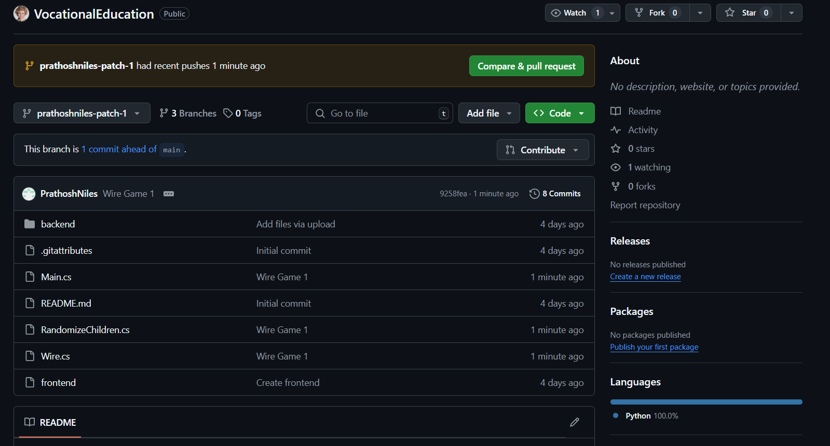
GitHub Commits
IT21347726 | Niles A.P | 24-25J-185

Slide 41

Work Done
IT21347726 | Niles A.P | 24-25J-185

Slide 42
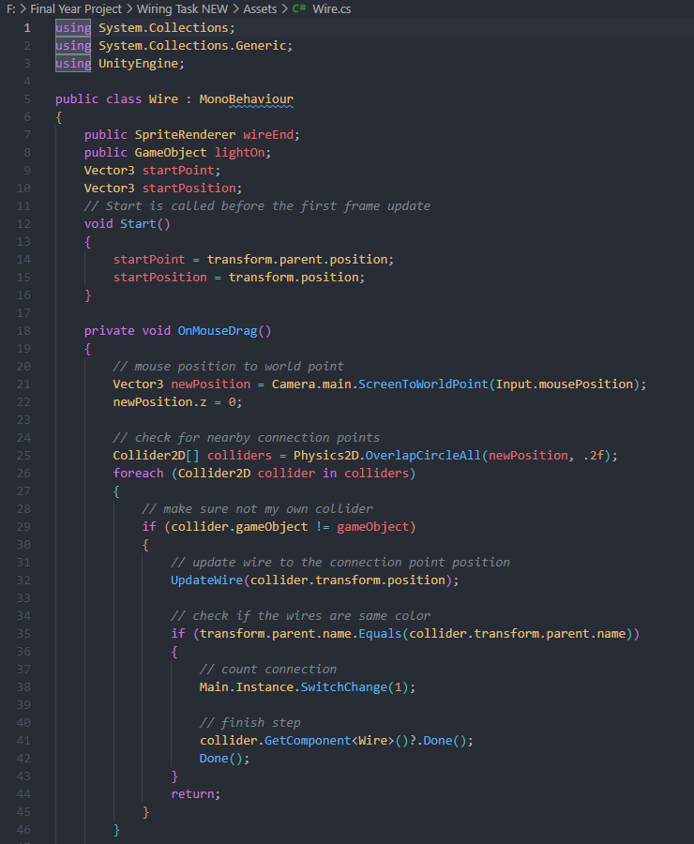
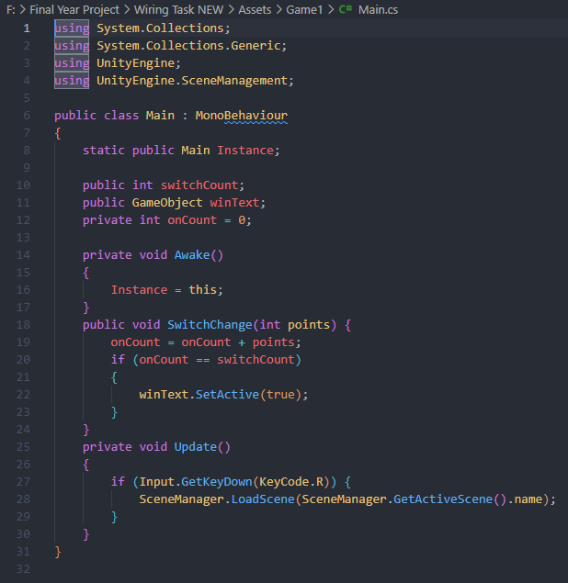
Work Done
IT21347726 | Niles A.P | 24-25J-185

Slide 43
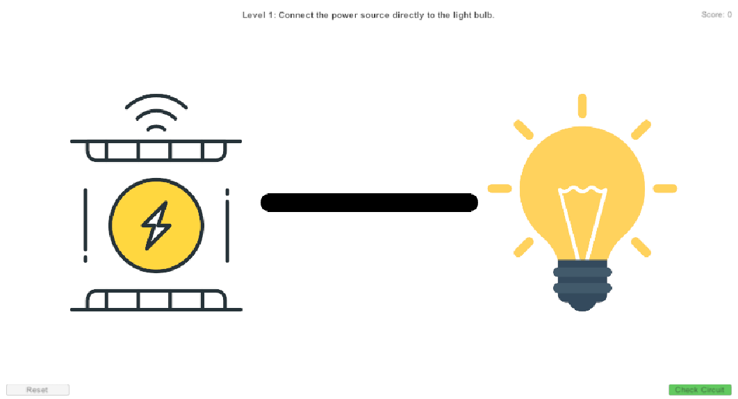
Work Done
IT21347726 | Niles A.P | 24-25J-185

Slide 44
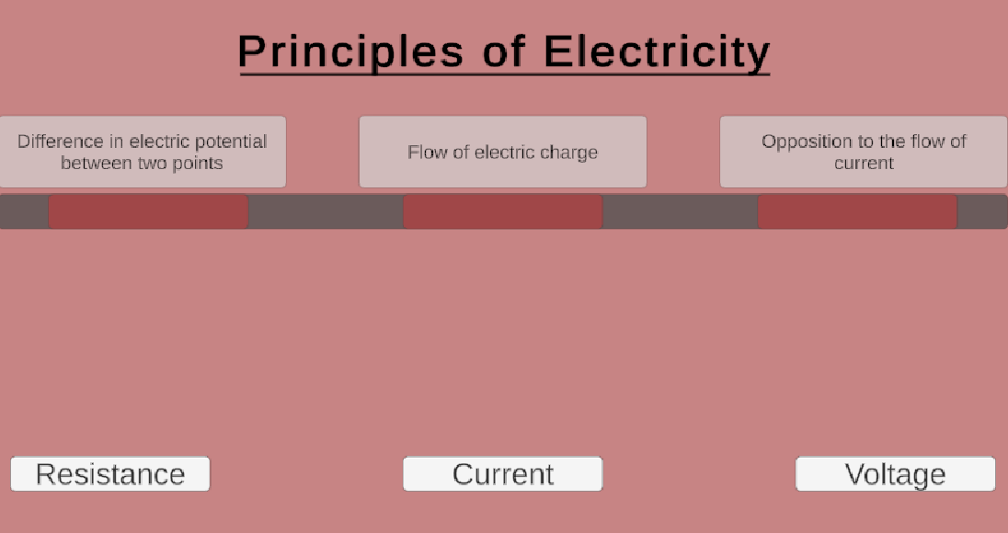
Work Done
IT21347726 | Niles A.P | 24-25J-185

Slide 45
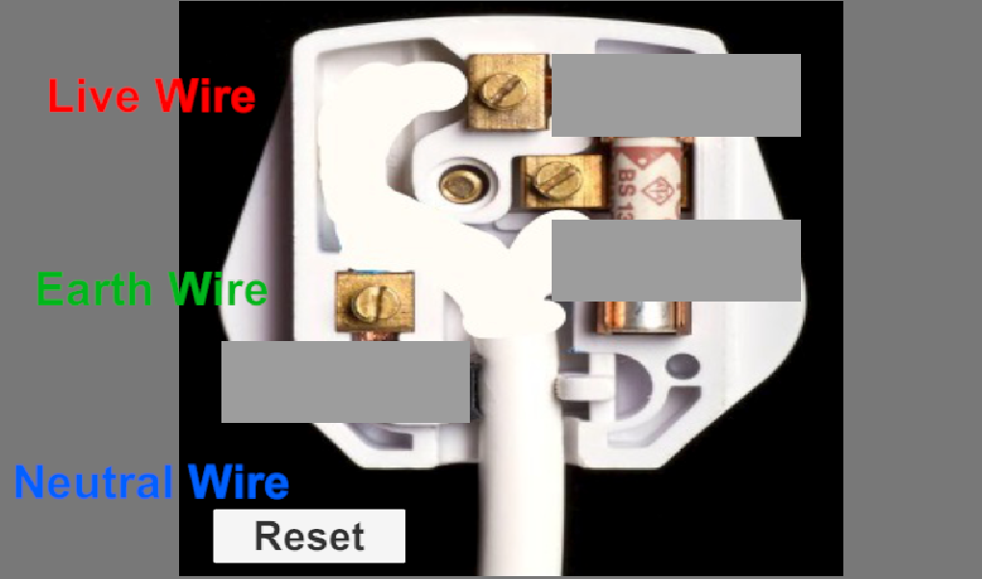
Work Done
IT21347726 | Niles A.P | 24-25J-185

Slide 46
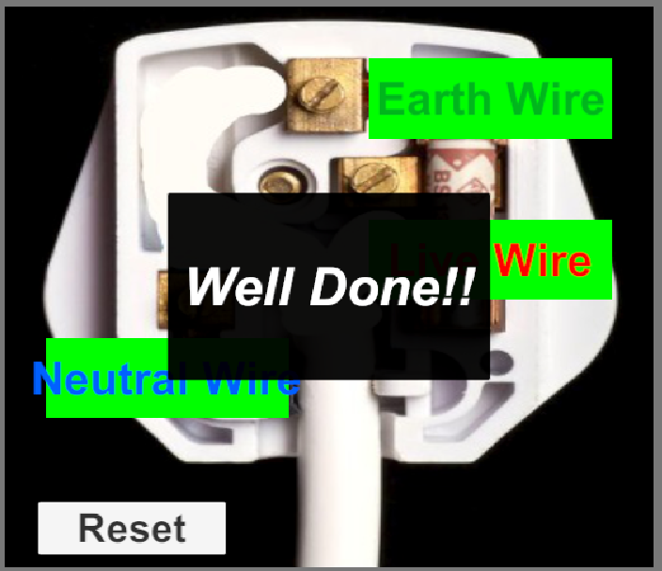
Work Done
IT21347726 | Niles A.P | 24-25J-185

Slide 47
References
[1] T. H. Hsu, K. H. Lin, and Y. C. Kuo, "Gamification for Vocational Education: An Empirical Study of a Gamified Learning System," IEEE Access, vol. 8, pp. 88910-88922, 2020. DOI: 10.1109/ACCESS.2020.2995947.
[2] M. Al-Ali, H. S. Al-Omari, and F. A. Al-Debei, "The Impact of Game-Based Learning on Vocational Training: A Case Study," IEEE Transactions on Education, vol. 62, no. 3, pp. 154-161, Aug. 2019. DOI: 10.1109/TE.2019.2915110.
[3] Y. G. Li, Y. H. Chen, and J. J. Huang, "Design and Evaluation of a Gamified Learning Platform for Vocational Training," IEEE Transactions on Learning Technologies, vol. 12, no. 1, pp. 60-69, Jan.-Mar. 2019. DOI: 10.1109/TLT.2018.2879476.
[4] L. H. Yang, J. C. Chen, and M. K. Tsai, "Integrating Gamification into Vocational Education: A Study on Learning Outcomes and Engagement," IEEE Transactions on Education, vol. 65, no. 4, pp. 381-388, Nov. 2022. DOI: 10.1109/TE.2022.3165629.
IT21347726 | Niles A.P | 24-25J-185

Slide 48


